Slide 1

Protocol Training Module

Slide 2
SHIELD Introduction
  Our hospital is participating in SHIELD, a nationally recognized quality improvement project to reduce multi-drug resistant organisms (MDROs) in healthcare facilities
    From this training you will learn:
    How to implement decolonization with chlorhexidine (CHG)
    How to implement decolonization with nasal iodophor
    How to address special circumstances related to decolonization
  This training module will take approximately 20 minutes to complete

Slide 3
What is Decolonization?
    Decolonization is the use of topical antiseptic soaps and nasal products to remove bacteria from the body surface
    Body bacteria have a higher chance of causing infection in hospitals and nursing homes due to wounds, devices, and poor health
    Decolonization is proven in hospital ICUs to prevent antibiotic resistant bacteria and bloodstream infections
    The decolonization products used in this project may include:
      Chlorhexidine 2% no-rinse impregnated cloths for bed baths
      Chlorhexidine 4% rinse-off liquid for showering
      Diluted Chlorhexidine 4% no-rinse liquid for bed baths
      Iodophor (povidone-iodine) for the nose

Slide 4
Why Decolonize?
    Why should we decolonize in hospitals?
      Body bacteria can cause infection in hospitals and nursing homes due to wounds, devices, and poor health of the patient
      Decolonization removes germs on the body that can cause infection
      Decolonization has been shown to prevent infections
        For patients with multidrug-resistant organisms (MDROs)
        In hospital ICUs
        In hospital patients with devices
        In long-term acute care hospitals

Slide 5
SHIELD Program Exclusions
    If a patient is allergic or develops an allergy to either iodophor or CHG, contact patient’s physician and simply discontinue the agent in question.
    As with any medical care, the patient can refuse the protocol, but your enthusiasm can often help them understand the value of removing germs on their body to protect them from infection

Slide 6
How Do I Perform
Universal Decolonization?
    Use chlorhexidine (CHG) for all bathing or shower needs for ALL adult patients on contact precautions for entire hospital stay
    Use nasal iodophor twice a day for 5 days starting on admission for ALL adult patients on contact precautions, for entire hospital stay
    Decolonization stops when discharged. If readmitted, protocol begins anew regardless of prior receipt of CHG or iodophor.

Slide 7

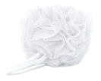
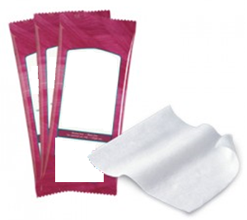
Options for Chlorhexidine (CHG)
for Routine Bed Bath
4% Liquid CHG*
    Rinse-off for showering
    Diluted to 2% for no-rinse, air dry,
    basin bed bath
  2% CHG cloths* (bed baths)
  No rinse, air dry
2% CHG Cloths
*The use of trade names is for identification only and does not imply endorsement by the Department of Health and Human Services or the Centers for Disease Control and Prevention.

Slide 8
Chlorhexidine for Bath or Shower
    Patients should be cleansed with chlorhexidine (CHG) in one of three ways
    Bed bath with 2% no-rinse CHG disposable cloths
    Basin bed bath with 4% liquid, diluted to 2%, no-rinse with non-medicated disposable cloths or wipes
    Shower with 4% rinse-off CHG liquid soap with mesh sponge
    CHG is the bathing/cleansing soap. It replaces regular soap. Do NOT use other soaps which can inactivate CHG.
    CHG works better than soap and water to remove bacteria. It should be firmly massaged into the skin. Once applied, it will continue to work to keep germs off the skin for 24 hours.
    CHG is less drying than regular soap and water
    For maximum protection, begin bathing on admission to remove germs being brought into the hospital

Slide 9
CHG Talking Points
Patients need encouragement for their bath
Your enthusiasm is critical to protect patients by bathing
Talking points:
  CHG reduces germs on your skin better than soap and water
  CHG serves as your protective bath to prevent infection
  The bath will only take about 10 minutes
  If you wish to bathe yourself, let me give you directions on how to use the soap to get rid of bacteria and protect you from infection. Let me help with hard-to-reach areas.
If your patient declines a bath, try again later in the day

Slide 10
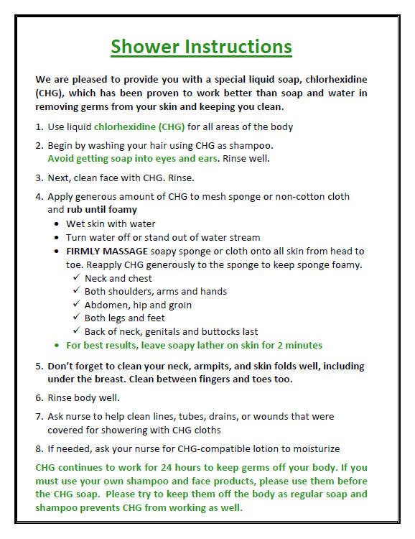
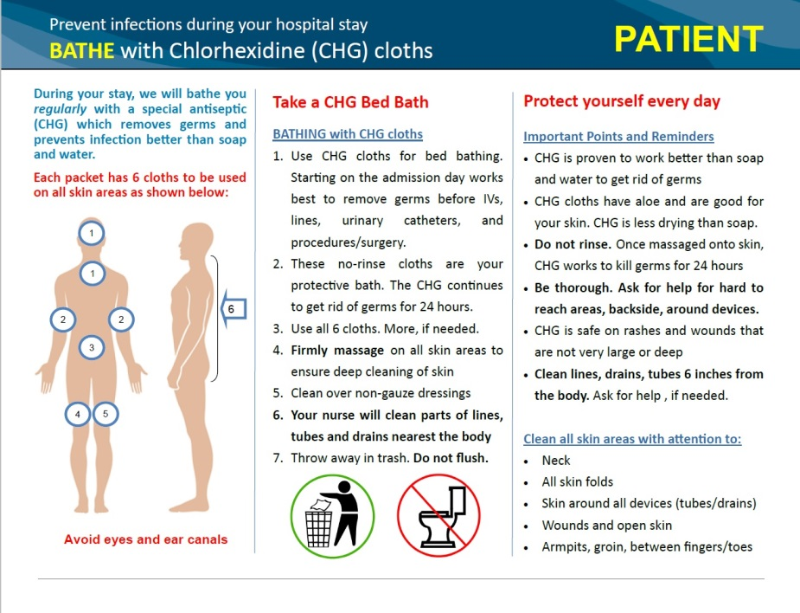
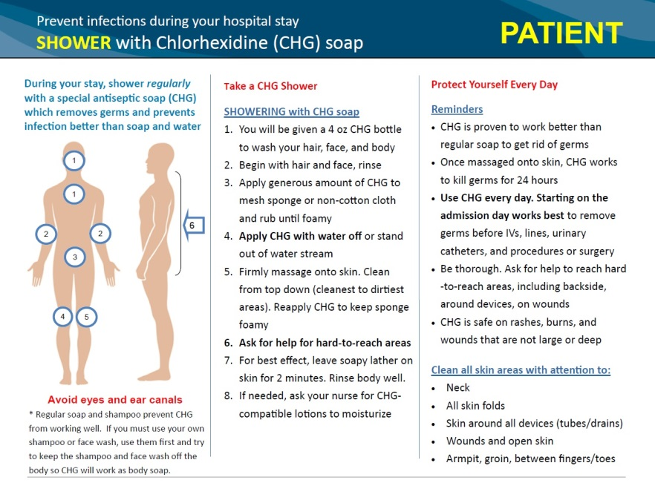
Patient Informational Handouts
One-page CHG bathing and showering informational handouts are available for patients
Providing patients with handout prior to bathing will save time (but should not replace verbal instructions)

Slide 11
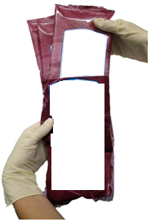


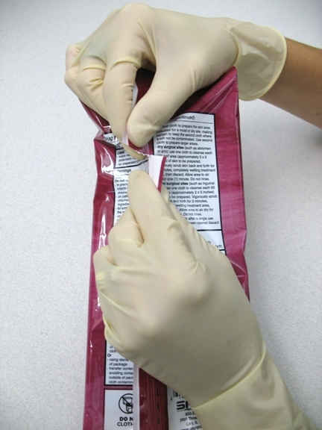
CHG Cloth Bathing
For patients who need a bed bath:
  Use CHG cloths* for all bathing needs
  Bathe with CHG cloths for entire hospital stay
  Use all 6 CHG cloths provided (3 packets of 2 cloths each)
  Obtain cloths from warmer
  Cloths are hard to open from the ends. Open pack at notch located on the back.
2% CHG Cloths
2% CHG Cloths
*The use of trade names is for identification only and does not imply endorsement by the Department of Health and Human Services or the Centers for Disease Control and Prevention.

Slide 12
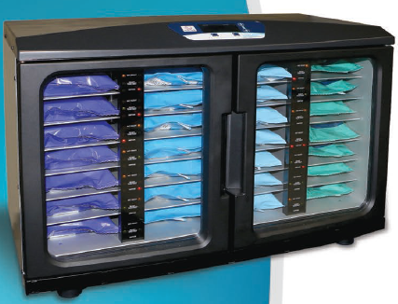
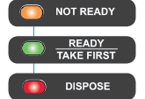
CHG Bathing Cloth
Warming Instructions
Warming is for comfort only. CHG works at room temperature.
Place CHG packs in warmer based on number of baths needed
Warmer lights change from “not ready” to “ready” after 2 hours
If warmer lights show “dispose” (after 84h), remove product and discard
After removing, replace with a new package
Caution: check temperature of cloth prior to use. Gloves diminish sense of heat.
Orange = Not ready (still warming)
Solid Green=Ready
Flashing Green= Take first
Red = expired, dispose

Slide 13
CHG Bathing Cloth
Warming Instructions
Do not waste cloths
Cloths cannot be reused
Take only what you need
Use cloths wisely

Slide 14
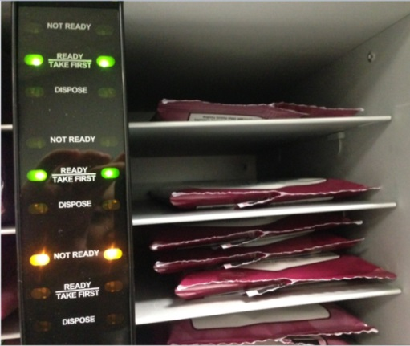
Extra CHG Bathing Cloths
  Sometimes extra CHG bathing cloths are needed, but be a good steward of CHG cloth use:
    Large body size (>300 lbs)
    Freshening up
    Reapplication after incontinence clean up
  Use a 2-cloth packet or “single” instead of the full 6 cloth bath:
    Separate packets and place into an individual slot in warmer
    Same warming instructions apply for separated packets
    Do not rewarm cloths
2% CHG Cloths
Single 2-cloth packet*
A slot can hold up to 3 singles
* The use of trade names is for identification only and does not imply endorsement by the Department of Health and Human Services or the Centers for Disease Control and Prevention.

Slide 15
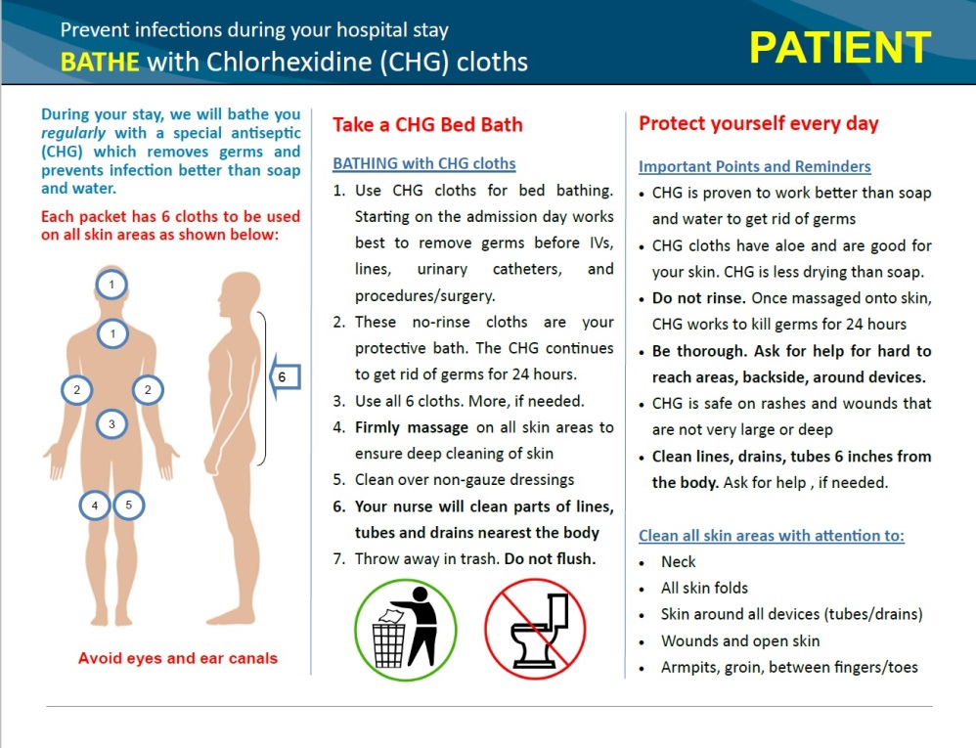
Before CHG Cloth Bed Bath
  Give patients the CHG bath handout
  Tell the patient
    These cloths are their protective bath
    No lather, but works better than soap and water
    Has aloe vera so less drying to skin than soap
    Aloe vera makes skin feel sticky for a few minutes
    No rinse for protective effect

Slide 16
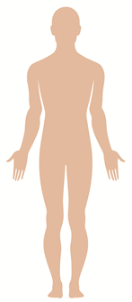

CHG Cloth Bathing Procedure
Firmly massage to remove bacteria.
Use ALL 6 CHG cloths in the following order:
  Face, neck & chest. Avoid eyes and ears.
  Both shoulders, arms and hands
  Abdomen & then groin/perineum
  Right leg & foot
  Left leg & foot
  Back of neck, back & then buttocks
  Clean 6 inches of all tubes, lines, and drains
  closest to the body
  Use more than 6 CHG cloths, as needed
  Safe on perineum, vaginal and external mucosa
1
1
6
2
2
3
4
5

Slide 17
Importance of Allowing
CHG to Fully Dry
CHG cloths contain aloe vera
  Aloe vera may feel sticky or tacky on patient’s skin when not fully dry
  Once the skin is dry this feeling will go away
Dressing changes
  Wound dressing or other dressings will not adhere to skin if CHG has not fully dried
  Ensure CHG is fully dried before changing and replacing dressings

Slide 18
Special Circumstances
  Devices
  Incontinence
  Wounds
  Obese patients

Slide 19
CHG Cloths and Devices
  Remember to clean not only the skin around the device, but the device itself to prevent infection. CHG is safe on devices.
  In the example of central lines:
  Ensure careful cleansing of skin around lines to remove bacteria
  After cleaning skin, clean 6 inches of line closest to the body
  Clean over semi-permeable dressings
  The same applies to other devices, such as drains, G or J -tubes,
  rectal tubes, chest tubes, EKG leads, urinary catheters:
    If dressing removed for changing, clean area well with CHG and fully dry before replacing dressing
    If dressing in place, clean over dressing. After skin is cleaned, use clean part of CHG cloth to clean at least 6 inches of tubing closest to patient.

Slide 20
CHG Cloths and Incontinence
Do NOT use soap to cleanse incontinent patients. Soap can inactivate CHG. Use barrier products compatible with CHG*
Remove urine/stool with usual incontinence wipes/cloths and water. Do NOT use soap.
Apply a single 2-cloth CHG pack and allow to air dry
Apply CHG-compatible barrier protection, if needed
If additional barrier protection is needed during day, OK to use additional CHG compatible barrier protection products
If additional bathing is required throughout the day, clean with CHG cloths, then reapply CHG compatible barrier protection products, as needed
*Contact manufacture for confirmation of CHG compatibility

Slide 21
CHG and Wounds
Use of CHG on wounds helps remove bacteria and prevent infection. CHG cloths or liquid CHG for showering can be used on all superficial wounds. These include:
  Superficial Decubitus Ulcers (Stage 1 & 2)
  Friable Skin/Rash
  Superficial Burns
- Clean the wound carefully with CHG, including over wound vacs
- CHG can be used over semi-permeable/occlusive dressings
- CHG can be applied over sutured or stapled wounds
- CHG cloths do not have alcohol and will not sting wounds
- Do NOT use on large or deep wounds (ex: packed wounds)

Slide 22
CHG Bathing of Obese Patients
  Nurses should use as many CHG cloths as necessary and throughout the day if additional bathing is required (incontinence, sweating, or other reasons)
Remind patient to ensure neck and all skin folds are well-cleaned
Dry well in skin folds

Slide 23

Can a Patient Self-Bathe?
Yes, with instruction and encouragement
Give handout to patient an hour or two before bathing
At bath time, go over the 1-page CHG cloth bathing handout

Slide 24
Can a Patient Self-Bathe?
Be sure to mention:
  Open packet at tear notch on back
  Cloths are a protective bath, kills germs for 24 hours
  CHG is safe, over-the-counter, and better than soap
  Air dry, do not rinse
  Massage (rather than wipe) into all areas of skin for effect
  Pay special attention to the neck, skin folds
  Remember, patients only feel comfortable cleaning normal skin:
    You will help them with hard to reach areas
    Clean all lines, tubes, drains within 6 inches of the body
    Ok to clean over semi-permeable dressings (not gauze)
    Safe on rashes, burns, wounds that are not deep or large

Slide 25
Bathing Clean Up
Dispose of each
washcloth in the trash
Do NOT flush washcloths in the toilet
Cloths CLOG toilets

Slide 26
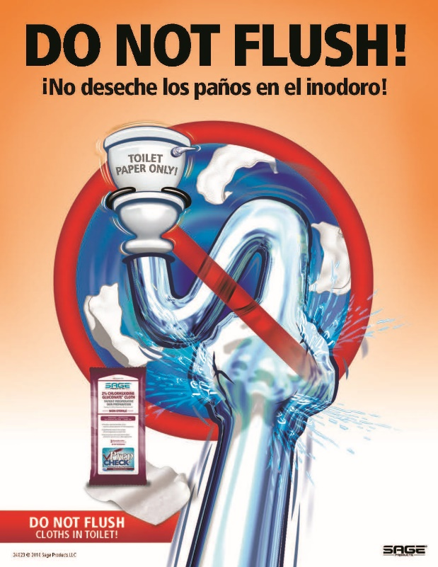
Do Not Flush Products
If desired, “Do Not Flush” posters are available for download at
Suggested uses: Patient rooms and bathrooms
https://sageproducts.com/do-not-flush/
8 ½ x 11 Poster

Slide 27
Long Term Use of CHG
    CHG has been used to safely bathe millions of patients, including patients in ICUs and burn units, and before and after surgery
    Long term use of CHG does not cause deterioration of skin or other problematic skin conditions. It is safe to use for routine bathing in patients who require prolonged care and has been shown to be better for the skin than regular soap and water.
    It is safe to use repeatedly in patients with multiple incontinent episodes

Slide 28
CHG Bathing Cloths
Critical Points to Remember
DO
  Use CHG cloths for all bathing
  Firmly massage skin to cleanse
  Pay special attention to neck and tubes, drains, lines
  Safe on rashes, cuts, scrapes
  Safe on burns, superficial wounds
  If readmitted, protocol starts anew
  Only use CHG compatible lotions*
  DON’T
  Do NOT wipe off. Let air dry.
  Do NOT save open packs for later use
  Do NOT flush
  Do NOT use on deep/large wounds
  Do NOT use on patient if allergic
  *Contact manufacture for confirmation of CHG compatibility
Notes:
28

Slide 29
CHG Showering Instructions
Patients who wish to shower should receive:
  1-page CHG shower instruction sheet 1-2 hours prior to showering
  Verbal review of instruction sheet
  CHG liquid (available in shower)
  Mesh sponge or non-cotton cloth to lather CHG onto body
  Do not use cotton cloths – cotton binds CHG and does not release CHG well onto the skin.
  Post-shower, help your patient apply a CHG cloth packet to any wrapped device or dressing within 6 inches of the body.

Slide 30
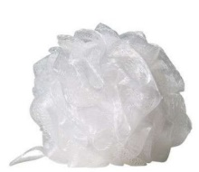
CHG Showering Instructions
Be sure to mention:
  CHG works better than soap and water to kill germs and keep them off the body for 24 hours if applied correctly
  Safe for shampoo and face/body wash. Avoid eyes/ears.
  If available, use a mesh sponge
    CHG foams well with it, but not without
  Apply to skin with out of water stream for 2 minutes before rinsing
  2 minutes is about the time it takes to soap up all body areas and then do it again before rinsing
  Massage all over skin. Pay attention to neck and skin folds.
If patients insist on using personal shampoo or face wash, but are willing to use CHG for body wash, have them avoid contacting other skin when using shampoo/other soaps and then apply CHG to other areas. Encourage only use of CHG if possible.

Slide 31
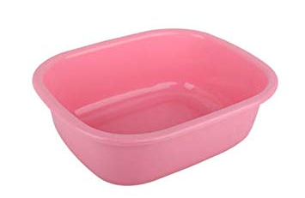

CHG Basin Bed Bath Instructions
What you will need
One 4 oz bottle of 4% Liquid CHG*
Bath Basin 6 Disposable Non-Medicated Cloths
*The use of trade names is for identification only and does not imply endorsement by the Department of Health and Human Services or the Centers for Disease Control and Prevention.

Slide 32
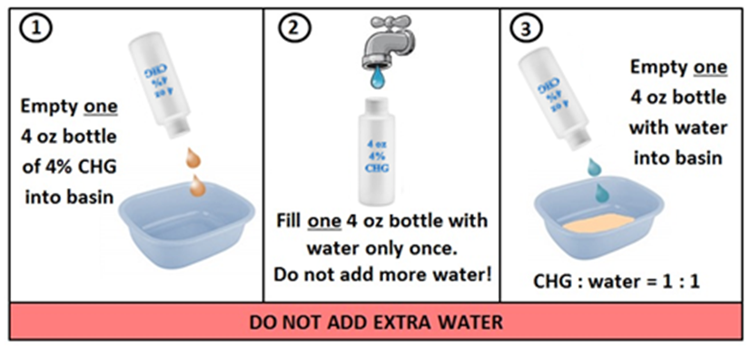
CHG Basin Bed Bath Instructions
  Obtain a bath basin and dispense one 4 oz bottle of 4% CHG liquid into basin.
  Fill one emptied 4 oz bottle with water and dispense it into basin with 4% CHG liquid in it. (IMPORTANT: Do NOT overdilute. Use only equal part of water and CHG. Goal is to achieve 2% CHG)
  3. Soak disposable wipes in basin. Wring each wipe prior to application. Only soak and wring each wipe once. DO NOT apply wipe to patient and place back in basin to rinse and apply again.

Slide 33
CHG Basin Bed Bath Bathing Procedure
Firmly massage to remove bacteria.
Use ALL 6 disposable wipes in the following order:
  Face, neck & chest. Avoid eyes and ears.
  Both shoulders, arms and hands
  Abdomen & then groin/perineum
  Right leg & foot
  Left leg & foot
  Back of neck, back & then buttocks
  Clean 6 inches of all tubes, lines, and drains
  closest to the body
  Use additional wipes for larger patients
  Safe on perineum and external mucosa
  Air dry. Do NOT rinse.
1
1
6
2
2
3
4
5

Slide 34
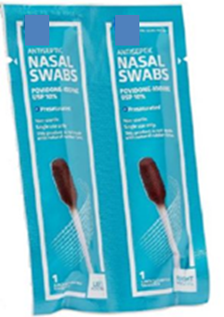
Nasal Decolonization
Nasal iodophor* is an antiseptic which is active against MRSA
It is topical and used in the front of the nose (nostrils)
Nasal iodophor will be used:
  For ALL adult patients on contact precautions
  Twice a day for 5 days on admission
Protocol stops upon discharge
If patients are readmitted, nasal iodophor protocol starts anew regardless of prior receipt of nasal iodophor
*The use of trade names is for identification only and does not imply endorsement by the Department of Health and Human Services or the Centers for Disease Control and Prevention.

Slide 35
How to Use Nasal Iodophor
Place patient’s bed at 30 degrees, if tolerated
Have patient use a tissue to blow their nose or clean the nares and tip of nostril. Discard tissue.
Insert first swab into one nostril and apply firmly to entire inner surface with a circular motion for 30 seconds (at least 3 times around slowly). Discard swab.
Using the second swab, repeat step 3 in the other nostril (swab 2)
Do this twice a day for 5 days
Patients should not blow nose. If needed, gently dab nostril opening with a tissue.
Notes:
35

Slide 36
Iodophor and Nasal Devices
    Removable Nasal Devices:
    If tolerated, briefly remove nasal prongs to apply nasal iodophor
    Nasal Endotracheal Tube/Nasogastric Tubes:
    Apply nasal iodophor around tube, if possible
    Nasal Trauma:
    Do NOT use nasal iodophor if nostril(s) are packed

Slide 37
Refusals
    As with any Quality Improvement project, consent is not required. However, patients should have the process explained to them so they understand the importance of decolonization.
    Similar to any medical care, the patient can refuse the protocol, but your enthusiasm can often help them understand the value of removing germs on their body to protect them from infection

Slide 38
CHG and Iodophor
Allergic Reactions
Nasal iodophor and CHG have minimal side effects
For nasal iodophor, side effects are uncommon, and may include brief itching and burning in the nose.
For CHG, side effects include rash in 1-3%
As with any drug, both mild and severe allergies (rare) can occur
If a CHG or iodophor reaction is suspected
  Contact the treating physician for all medical assessment and treatment decisions
Notes:
38

Slide 39
Decolonization: Key Points
  Use CHG for entire hospital stay for adult ICU patients and adult patients on contact precautions
  Begin CHG and iodophor on admission to protect patients
  Be encouraging and supportive. Patients will bathe with your enthusiasm.
  Give the bathing/showering handout to read before the bath/shower
  Patients who self-bathe still need verbal directions
  Clean lines, tubes, drains, dressings, and wounds unless large or deep
  Allow CHG to air dry
  Use nasal iodophor twice a day for 5 days on admission.
  The protocol begins again if patients are readmitted

